Slide 1

IEEE TRANSACTIONS ON ULTRASONICS, FERROELECTRICS, AND FREQUENCY CONTROL, VOL. 65, NO. 7, JULY 2018
Ultrafast imaging in biomedical ultrasound
Reporter: Renxin Zhuang

Slide 2

Outline
Review(2014)
Coherent Plane-Wave Compounding for Very High Frame Rate Ultrasonography and Transient Elastography(2009)
Ultrafast Ultrasound Imaging Using Combined Transmissions With Cross-Coherence-Based Reconstruction(2018)
Ultrafast Ultrasound Imaging With Cascaded Dual-Polarity Waves(2018)

Slide 3
Outline
Review(2014)
Coherent Plane-Wave Compounding for Very High Frame Rate Ultrasonography and Transient Elastography(2009)
Ultrafast Ultrasound Imaging Using Combined Transmissions With Cross-Coherence-Based Reconstruction(2018)
Ultrafast Ultrasound Imaging With Cascaded Dual-Polarity Waves(2018)

Slide 4
Review
What is ultrafast: typically over 1000 frames per second(fps)
Ultrafast imaging is obtained by transmitting a wide field-of-view beam(i.e.plane wave) which can scan in a single transmit event over the whole region of interest.
For example, suppose the speed of ultrasound is 1540m/s and the exploration depth is 15cm, then the frame rate is computed as 1540/(0.15*2), which is over 5000fps

Slide 5
Review
The development of ultrafast imaging(1970s-now)
In 1977, the ultrafast terminology is first coined in a seminal paper entitled “Ultrafast echotomographics system using optical processing of ultrasonic signals” by Bruneel et al.
In 1979, Delannoy et al. demonstrated the power of using receiving electronics with analog parallel processing instead of using an optical system.
Years after that, Shattuck et al. implemented a parallel processing approach which enabled the simultaneous acquisition of several B-mode lines. Their first system can process in parallel 4 ultrasonic beams in the receive mode and thus increase the data acquisition rate four times.
[1] c. Bruneel, r. Torguet, K. M. rouvaen, E. Bridoux, and B. nongaillard, “Ultrafast echotomographic system using optical processing of ultrasonic signals,” Appl. Phys. Lett., vol. 30, no. 8, pp. 371–373, 1977.
[2] B. delannoy, r. Torguet, c. Bruneel, E. Bridoux, J. M. rouaven, and H. lasota, “acoustical image reconstruction in parallel-processing analog electronic systems,” J. Appl. Phys., vol. 50, no. 5, pp. 3153–3159, 1979.
[3] d. shattuck, M. Weinshenker, s. smith, and o. von ramm “Explososcan: a parallel processing technique for high speed ultrasound imaging with linear phased arrays,” J. Acoust. Soc. Am., vol. 75, no. 4, pp. 1273–1282, apr. 1984.

Slide 6
Review
The development of ultrafast imaging(1970s-now)
From 1980s to 2000s, Fink's research group demonstrated that the concept of plane-wave illuminations and massive parallel receive beamforming could lead to ultrafast frame rates that were higher than a thousand fps.
In 2002, Tanter, one member of Fink's group, introduced plane-wave compounding, which includes transmission of tilted plane waves with different angles. This is termed incoherent plane-wave compounding.
Based on the idea of virtual dynamic transmit focusing, Montaldo, also one member of Fink's group, experimentally applied this concept of coherent summation of virtual dynamic transmit focusing to plane-wave transmissions, which ultimately resulted in coherent plane-wave compounding in 2009(CPWC).
[1] J. Bercoﬀ, s. chaﬀai, M. Tanter, l. sandrin, s. catheline, M. Fink, J. l. Gennisson, and M. Meunier, “In vivo breast tumor detection using transient elastography,” Ultrasound Med. Biol., vol. 29, no. 10, pp. 1387–1396, 2003.
[2] M. Tanter, J. Bercoﬀ, l. sandrin, and M. Fink, “Ultrafast compound imaging for 2-d motion vector estimation: application to transient elastography,” IEEE Trans. Ultrason. Ferroelectr. Freq. Control, vol. 49, no. 10, pp. 1363–1374, 2002.
[3] G. Montaldo, M. Tanter, J. Bercoﬀ, n. Benech, and M. Fink, “coherent plane-wave compounding for very high frame rate ultrasonography and transient elastography,” IEEE Trans. Ultrason. Ferroelectr. Freq. Control, vol. 56, no. 3, pp. 489–506, 2009.

Slide 7
Review
The development of ultrafast imaging(1970s-now)
Parallel to the representative work of CPWC that transmits plane-waves, another prevalant approach called synthetic aperture imaging(SA) , which transmits spherical waves, was proposed by the research groups of Jensen and Lockwood.
SA is based on single element transmissions and synthetic recombination of backscattered echoes, so it is not applied to ultrafast imaging because the number of transmit events is similar to that of conventional line-per-line focusing.
To increase the frame rate of SA imaging, sparse synthetic aperture imaging was proposed but it suffers from low SNR. For this reason, Lockwood et al. simulated sub-aperture made of several elements which generated a diverging wave. In this way, it only requires a few emissions, resulting in a compromise between ultrafast imaging and SA imaging.
[1] s. I. nikolov and J. a. Jensen, “In-vivo synthetic aperture ﬂow imaging in medical ultrasound,” IEEE Trans. Ultrason. Ferroelectr. Freq. Control, vol. 50, no. 7, pp. 848–856, 2003.
[2] G. r. lockwood, J. r. Talman, and s. s. Brunke, “real-time 3d ultrasound imaging using sparse synthetic aperture beamforming,” IEEE Trans. Ultrason. Ferroelectr. Freq. Control, vol. 45, no. 4, pp. 980–988, 1998.
[3] s. I. nikolov and J. a. Jensen, “Virtual ultrasound sources in highresolution ultrasound imaging,” in Proc. SPIE, 2002, vol. 3, pp. 395–405.

Slide 8
Review
The development of ultrafast imaging(1970s-now)
Ultrafast plane-wave imaging has been employed in the first ultrafast clinical scanner, the Aixplorer system, since 2008.
Other devices, such as the Verasonics platform, have been commercialized for use in academic research labs.

Slide 9
Outline
Review(2014)
Coherent Plane-Wave Compounding for Very High Frame Rate Ultrasonography and Transient Elastography(2009)
Ultrafast Ultrasound Imaging Using Combined Transmissions With Cross-Coherence-Based Reconstruction(2018)
Ultrafast Ultrasound Imaging With Cascaded Dual-Polarity Waves(2018)

Slide 10
Coherent Plane-Wave Compounding
Difference between plane-wave imaging and conventional imaging with focused beam
In conventional imaging, both transmit focusing and receive focusing are present.
In single plane-wave imaging, there is only focusing in the reveive mode. So the quality of the image is degraded in terms of contrast and resolution.

Slide 11
Coherent Plane-Wave Compounding
Difference between single plane-wave imaging and coherent plane wave compounding
Coherent compounding of ultrasonic images acquired with different plane waves at tilted angles virtually rebuild the transmit focusing process for conventional imaging.
Note that the compounding is produced without taking the envelope of the beamformed signals or any other nonlinear procedure to ensure a coherent addition.
Relying on dynamic focusing in both transmit and receive modes, this coherent compounding process allowed for better image quality in plane-wave compounding compared with conventional ultrasound without compromising the ultrafast frame rate.(See Fig. 1)

Slide 12
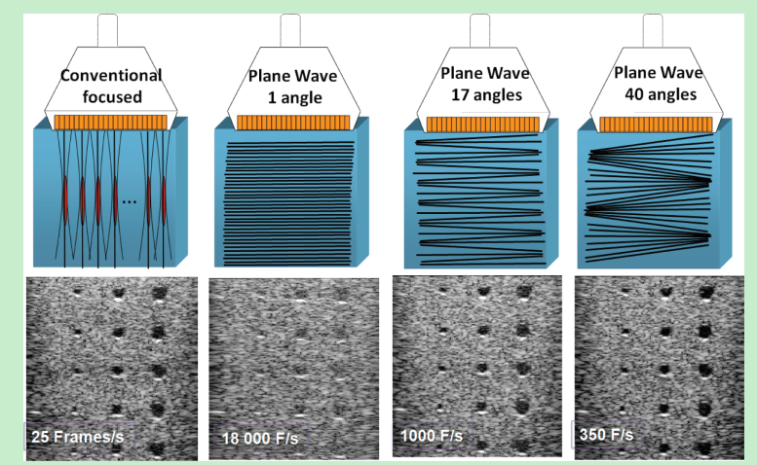
Coherent Plane-Wave Compounding
Fig. 1. conventional focused and ultrafast ultrasound imaging sequences for a typical medical imaging setup (4-cm deep region of interest): (a)
conventional focused imaging (128 focused beams and 4 focal depths leading to ~25 fps), (b) plane-wave imaging (~18000 fps), (c) plane-wave compounding with 17 angles (~1000 fps), and (d) plane-wave compounding with 40 angles (~350 fps).

Slide 13
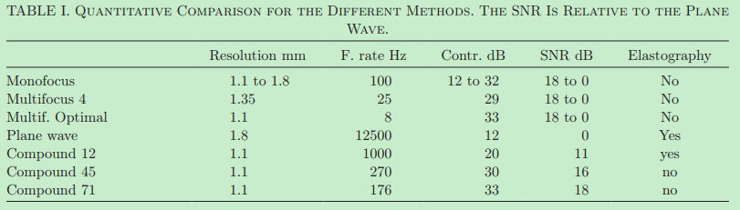
Coherent Plane-Wave Compounding
Theoretically, to obtain the same focusing quality as the optimal multifocus with 12 focal depths, it requires 71 plane waves insonifications.
Experimentally, Table I summarizes the comparison between different imaging methods.
We demonstrated here that the coherent compounding approach performs as well as the optimal multifocus image but with a signifcantly higher frame rate.

Slide 14
Outline
Review(2014)
Coherent Plane-Wave Compounding for Very High Frame Rate Ultrasonography and Transient Elastography(2009)
Ultrafast Ultrasound Imaging Using Combined Transmissions With Cross-Coherence-Based Reconstruction(2018)
Ultrafast Ultrasound Imaging With Cascaded Dual-Polarity Waves(2018)

Slide 15
Combined Transmissions With Cross-Coherence-Based Reconstruction
Motivation and Contribution
CPWC and SA imaging are not capable of suppressing the axial ghost artifact and side lobes.
The authors proposed a new ultrafast imaging framework. In transmission, combined transmissions with a PW illumination by full aperture and two diverging spherical waves by edge array elements are exploited to ensure the ultrafast acquisitions.
The ghost echoes in the backscattered signals by PW transmissions are reduced with the combined diverging SW transmissions.
A new cross-coherence factor (CCF) is devised with delayed backscattered signals by combined transmissions to reduce side lobe artifacts.

Slide 16
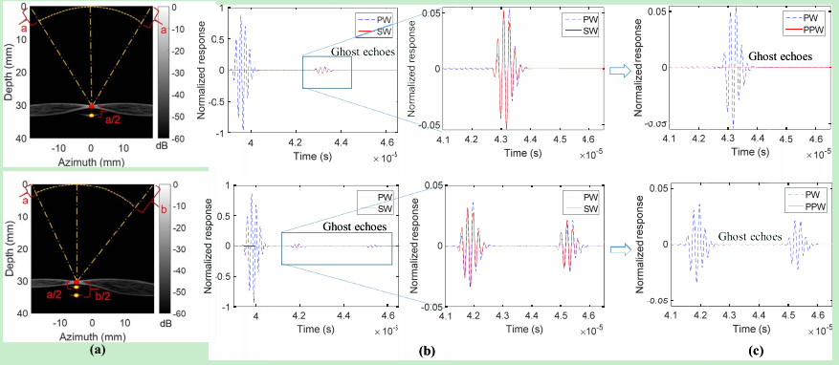
Combined Transmissions With Cross-Coherence-Based Reconstruction
Methods: reduction of axial ghost artifact
The amplitude and phase of the ghost echoes by PW were found to be comparable to those of the echoes by averaged SWs(Fig. 2 (b)).
Fig. 2. Axial ghost echoes and axial lobe artifacts for centered (top panel) and off-centered (bottom panel) point targets: (a) the location of the axial lobe artifact in plane-wave (PW) imaging; (b) backscattered signals by PW and two averaged spherical-wave (SW) transmissions; (c) backscattered signals with suppressed ghost echoes. PPW denotes the preprocessed backscattered signal by PW.

Slide 17

Combined Transmissions With Cross-Coherence-Based Reconstruction
Methods: reduction of axial ghost artifact
Based on the high similarity between the PW ghost echoes and the averaged SWs, a correlation coefficient is calculated for every sample in the backscattered signals of each channel using segments of backscattered signals between two adjacent zero-crossing points, as follows:
where n₁ and n₂ are two adjacent zero-crossing points, index n indicates the n-th sample in the backscattered signals of the m-th channel, s_{lr} (m, n) is the averaged backscattered signal by two SWs, s_{p}(m, n) is the backscattered signal by PW, and μ_{lr} and μ_{p} are the average values of the backscattered signals by SW and PW, respectively.

Slide 18


Combined Transmissions With Cross-Coherence-Based Reconstruction
Methods: reduction of axial ghost artifact
The energy ratio between backscattered signals by PW and SW was
The final coefficient λ is then given by
The preprocessed backscattered signal by PW was the multiplication of the coefficient λ and the original signal.

Slide 19
Combined Transmissions With Cross-Coherence-Based Reconstruction
Methods: reduction of side lobe artifact
Side lobe artifacts are caused by the interference signal from the off-focus target. This type of artifact exists on the left and right sides of the imaging target as shown in Fig. 2(a).
The varied interference signal from off-focus target leads to the diversity of the aperture data from multiple transmissions. So the authors designed a new factor, cross-coherence factor (CCF), to evaluate the similarity or the diversity of the aperture data from multiple transmissions.
The larger the diversity is of the multiple aperture data, the smaller is the CCF.
The aperture data refer to the data received by each array channel after the focusing delays are applied.

Slide 20


Combined Transmissions With Cross-Coherence-Based Reconstruction
Methods: reduction of side lobe artifact
To measure the diversity of two aperture data, x and y, the formula is
where N is the number of samples
It can be simplified as
where μ_{x} and μ_{y} are the mean values, and σ_{x} and σ_{y} are the standard deviations.

Slide 21


Combined Transmissions With Cross-Coherence-Based Reconstruction
Methods: reduction of side lobe artifact
Since we have three aperture data, three factors can be obtained from each pair. We can write a matrix as
Then, the final coefficient can be obtained by

Slide 22

Combined Transmissions With Cross-Coherence-Based Reconstruction
Methods: reduction of side lobe artifact
Finally, the square root of the derived coefficient is used as the multiplex factor for the sum of the respective averages of the three aperture data, to obtain final beamformed RF data for each pixel,
where A₁, A₂, and A₃ are the respective averages of the three aperture data.
Beamformed RF data are envelope-detected to yield a B-mode image.

Slide 23
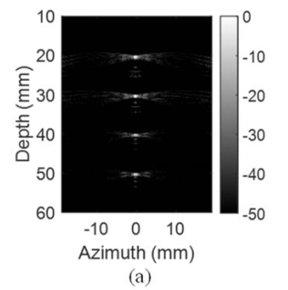
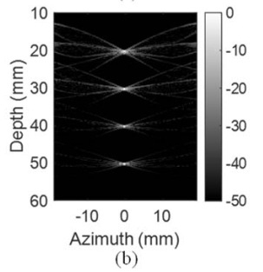
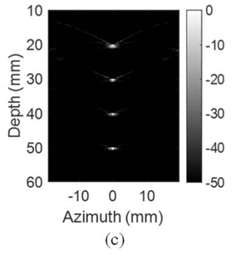
Combined Transmissions With Cross-Coherence-Based Reconstruction
Experiment: Simulation
Figure 3 shows the B-mode images of a simulated point target phantom using CPWC(3 PWs), CSWC(3 SWs), and the proposed US-CTCC method(ε₁ = 0.1, ε₂ = 10, and μ = 0.02).
Fig. 3. Images of four point targets with a 50 dB dynamic range by (a) coherent compounding with three plane waves (3 PWs) at −7 degrees, 0 degrees, and 7 degrees, (b) coherent compounding with three spherical waves (3 SWs) from the leftmost, center, and rightmost elements, and (c) our proposed method with combined transmissions (US-CTCC).

Slide 24
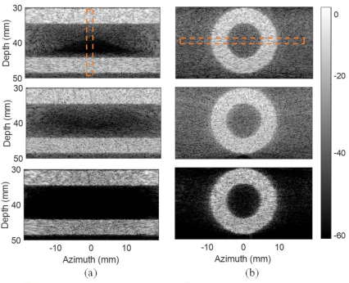
Combined Transmissions With Cross-Coherence-Based Reconstruction
Experiment: Phantom
The images and profiles of the simulated hollow cylindrical phantom in the longitudinal and transverse views are shown in Fig. 4. The reduction of artifacts in the lumen of（在管腔里） the phantom by our proposed method was observed.
Fig. 4. Images of a simulated hollow cylindrical phantom in (a) the longitudinal view and (b) the transverse view displayed with a 60 dB dynamic range by (top) coherent compounding with three plane waves (3 PWs) at −7 degrees, 0 degrees, and 7 degrees, (middle) coherent compounding with three spherical waves (3 SWs) from the leftmost, center, and rightmost elements, and (bottom) our proposed method with combined transmissions (US-CTCC).

Slide 25
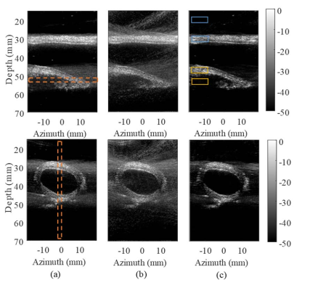
Combined Transmissions With Cross-Coherence-Based Reconstruction
Experiment: Ex Vivo Porcine Aorta（猪主动脉）
The images of the proposed method show better boundary delineation than those by CPWC and CSWC imaging in both the longitudinal and transverse views.
Fig. 5. Images of an excised porcine aorta with a 50 dB dynamic range in the longitudinal (top) and transverse (bottom) views: (a) coherent compounding with three plane waves (3 PWs) at −7 degrees, 0 degrees, and 7 degrees, (b) coherent compounding with three spherical waves (3 SWs) from the leftmost, center, and rightmost elements, and (c) our proposed method with combined transmissions (US-CTCC).

Slide 26
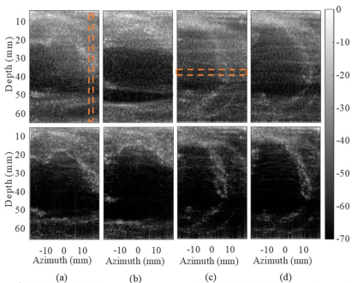
Combined Transmissions With Cross-Coherence-Based Reconstruction
Experiment: In Vivo Porcine Heart（猪心脏）
The proposed US-CTCC shows better boundary delineation of the left ventricular（左心室） wall than CPWC. In addition, US-CTCC shows a better reduction of artifacts in the cavity（在腔里） than CPWC.
Fig. 6. Images of an in vivo porcine heart displayed with a 70 dB dynamic range in the long-axis view: (a) in systole with CPWC (top) and USCTCC (bottom), (b) in diastole with CPWC (top) and US-CTCC (bottom), and the short-axis view: (c) in systole with CPWC (top) and US-CTCC (bottom), and (d) in diastole with CPWC (top) and US-CTCC (bottom).

Slide 27
Combined Transmissions With Cross-Coherence-Based Reconstruction
Limitations
A relatively low sonographic SNR (SNRs) of the backscattered signals by SWs from edge array elements was noted.
Despite the improved contrast between the vessel wall and lumen, the CNR was compromised by the increased standard deviation of the signal intensity.
The added computational cost from the preprocess procedure and the calculation of the CCF for each pixel might be a potential concern in real-time ultrafast imaging.
In theory, the framework is expected to work as well with more than three transmissions (i.e., multiple tilted plane waves with two SWs by edge array elements).

Slide 28
Outline
Review(2014)
Coherent Plane-Wave Compounding for Very High Frame Rate Ultrasonography and Transient Elastography(2009)
Ultrafast Ultrasound Imaging Using Combined Transmissions With Cross-Coherence-Based Reconstruction(2018)
Ultrafast Ultrasound Imaging With Cascaded Dual-Polarity Waves(2018)

Slide 29
Cascaded Dual-Polarity Waves
Motivation
The ultrafast image SNR is limited due to the few number of unfocused wave transmissions.
Both the frame rate and SNR are valuable for medical ultrasound imaging. Higher SNR enables deep tissue imaging and the use of higher frequencies, together yielding images with better resolution and constrast.
Due to the safety issues of the medical ultrasound imaging, the maximum allowable Mechanical Index (MI) limits the maximum amplitude of the transmitted signals, thus limiting SNR.
How to increase the SNR without changing the amplitude of the transmitted signals needs to be investigated.

Slide 30
Cascaded Dual-Polarity Waves
Theory: Conventional Single-Wave Model
In all signal models, x(t) represents the transmitted signals. The transmitted signals will propagate and interact with soft tissues, and backscattered signals y(t) are recorded for each transmission-reception event.
In conventional single wave transmission, the signals for each pair of successive transmissions are given by
x₁ (t) = a₁ · s₁ (t)
x₂ (t) = a₂ · s₂ (t)
where s₁(t) and s₂(t) represent the source signals, and a₁ and a₂ represent the coefficients of the signals with a given value of −1 or +1.

Slide 31
Cascaded Dual-Polarity Waves
Theory: Conventional Single-Wave Model
From each transmission, the noise-free received signals can be described by
y₁ (t) = a₁ · s₁ (t) ∗ h(t)
y₂ (t) = a₂ · s₂ (t) ∗ h(t)
where ∗denote the convolution operation and h(t) is the impulse response.

Slide 32

Cascaded Dual-Polarity Waves
Theory: Multiplane Wave Model With Hadamard Matrix(MW)
The Hadamard encoding scheme is the starting point of coded waves, in which the signals for each pair of successive transmissions are given by
x_{h1} (t) = a₁₁ · s₁ (t) + a₁₂ · s₂ (t) ∗ δ(t − τ)
x_{h2} (t) = a₂₁ · s₁ (t) + a₂₂ · s₂ (t) ∗ δ(t − τ)
where x_{h1}(t) is the first transmission, x_{h2}(t) is the second transmission, τ is the preset delay added between the first wave s₁(t) and the second wave s₂(t), and a₁₁, a₁₂, a₂₁, a₂₂ are the values of the Hadamard matrix of order 2, which is given by

Slide 33
Cascaded Dual-Polarity Waves
Theory: Multiplane Wave Model With Hadamard Matrix(MW)
The received signals from each transmission can be written as
y_{h1} (t) = s₁ (t) ∗ h(t) + s₂ (t) ∗ δ(t − τ) ∗ h(t)
y_{h2} (t) = s₁ (t) ∗ h(t) − s₂ (t) ∗ δ(t − τ) ∗ h(t)
The received signals with a 2-fold amplitude increase can be retrieved based on simple linear decoding as follows:
y′_{h1} (t) = y_{h1} (t) + y_{h2} (t) = 2 · s₁ (t) ∗ h (t)
y′_{h2} (t) = y_{h1} (t) − y_{h2} (t) = 2 · s₂ (t) ∗ δ(t − τ) ∗ h(t)
The delay τ is known, the second received signal, y′_{h2}(t), can be compensated as follows:
y′′_{h2} (t) = y′_{h2}(t) ∗ δ(t + τ) = 2 · s₂ (t) ∗ h(t)

Slide 34



Cascaded Dual-Polarity Waves
Theory: Proposed Cascaded Dual-Polarity Waves Model(CDW)
The 2×2 CDW matrix is the same as Hadamard Matrix. The 2×4 CDW matrix can be designed by the 2×2 matrix
1) A 2-by-4 matrix is first written by repeating H_{2×2}:
2) Another 2-by-4 matrix
3) The final 2-by-4 CDW matrix, C_{2×4}, is obtained by the element-wise multiplication of C′_{2 ×4} and C′′_{2×4} as

Slide 35
Cascaded Dual-Polarity Waves
Theory: Proposed Cascaded Dual-Polarity Waves Model(CDW)
The first and second rows in C_{2×4} represent the first and second transmissions, respectively.
The signals for each pair of successive transmissions with four waves can therefore be formulated as
x_{s1} (t) = s₁ (t) + s₁ (t) ∗ δ (t − τ) + s₂ (t) ∗ δ (t − 2τ) − s₂ (t) ∗ δ (t − 3τ)
x_{s2} (t) = s₁ (t) − s₁ (t) ∗ δ (t − τ) + s₂ (t) ∗ δ (t − 2τ) + s₂ (t) ∗ δ (t − 3τ)

Slide 36
Cascaded Dual-Polarity Waves
Theory: Proposed Cascaded Dual-Polarity Waves Model(CDW)
The received signals will be
y_{s1} (t) = s₁ (t) ∗ h (t) + s₁ (t) ∗ δ (t − τ) ∗ h (t)
+ s₂ (t) ∗ δ (t − 2τ) ∗ h(t) − s₂ (t) ∗ δ (t − 3τ) ∗ h(t)
y_{s2} (t) = s₁ (t) ∗ h (t) − s₁ (t) ∗ δ (t − τ) ∗ h (t)
+ s₂ (t) ∗ δ (t − 2τ) ∗ h(t) + s₂ (t) ∗ δ (t − 3τ) ∗ h(t)
Following the same operations(addition, subtraction, delay) in multiplane wave model, the final decoded signals with 4 times higher amplitude than those of y₁(t) and y₂(t) will be
y′′_{s1} (t) = 4 · s₁ (t) ∗ h (t) = 4 · y₁ (t)
y′′′_{s2} (t) = 4 · s₂ (t) ∗ h (t) = 4 · y₂ (t)

Slide 37
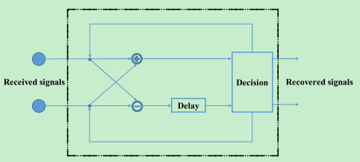
Cascaded Dual-Polarity Waves
Theory: Proposed Cascaded Dual-Polarity Waves Model(CDW)
Figure 7 shows the general decoding process.
Fig. 7. The proposed decoding process for the CDW coding matrix
The decider is used to send the processed signals for the next loop or the final decoded output signals.
The number of the loops is L = log2(N) with N waves.

Slide 38
Cascaded Dual-Polarity Waves
Experiment
The authors use eight cascaded dual-polarity waves, which means the size of the CDW matrix is 2x8.
Figure 3 shows the two-transmit sequence of our proposed CDW imaging with eight cascaded waves for each transmission.

Slide 39
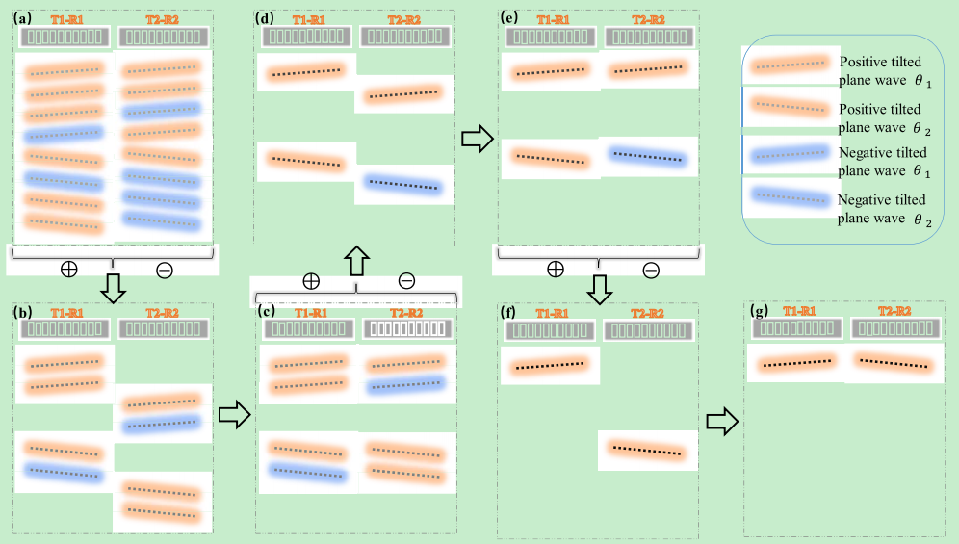
Cascaded Dual-Polarity Waves
Experiment
Fig. 3. Illustration of the 8 cascaded wave transmission sequence and reception decoding sequence design of our proposed CDW imaging.

Slide 40
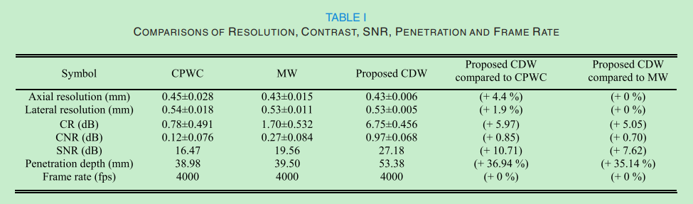
Cascaded Dual-Polarity Waves
Experiment
Table I shows the axial and lateral resolutions, CR, CNR, SNR, penetration depth, and the frame rate of CPWC, MW and CDW imaging.

Slide 41
Cascaded Dual-Polarity Waves
Discussion
By using N cascaded waves with an allowed transmitted voltage in CDW imaging, the SNR gain would, in theory, be 10 · log₁₀(N) compared with the single wave model in CPWC.
The computational cost mainly depends on the size of the 2D matrix.
It is better that we implement the decoding process on the initially received signals before the beamforming process.
The type of the wave in CDW imaging can be the plane wave, diverging wave, focused wave, or other forms.
The time interval among the cascaded waves is only 1.2 µs for eight cascaded waves.

Slide 42
THANKS!

